Slide 1
HUBBUB
RAILS
Error 403: Sleep Forbidden
Sharon Qiu, David Wing, Neel Mansukhani, Leah Gillespie, Sri Ramya Dandu
Notes:
Leah

Slide 2
Overview
01
05
About the Project
Routing
02
06
Testing
ER Diagram
03
07
Frameworks
Demo
04
08
State Diagram
Impact
A quick overview
A more in-depth look into our routing
It works!
A look into our databases
and its relationships
All of the tools that makes our application work
A look into our app
A diagram showing the state and condition of the application during run
Where to go from here
Notes:
Leah

Slide 3
About Hubbub
HUBBUB
Hubbub is a resource–primarily geared towards students and clubs–that allows students to connect with clubs based on their interests and current matches.
Leah
Notes:
Leah

Slide 4
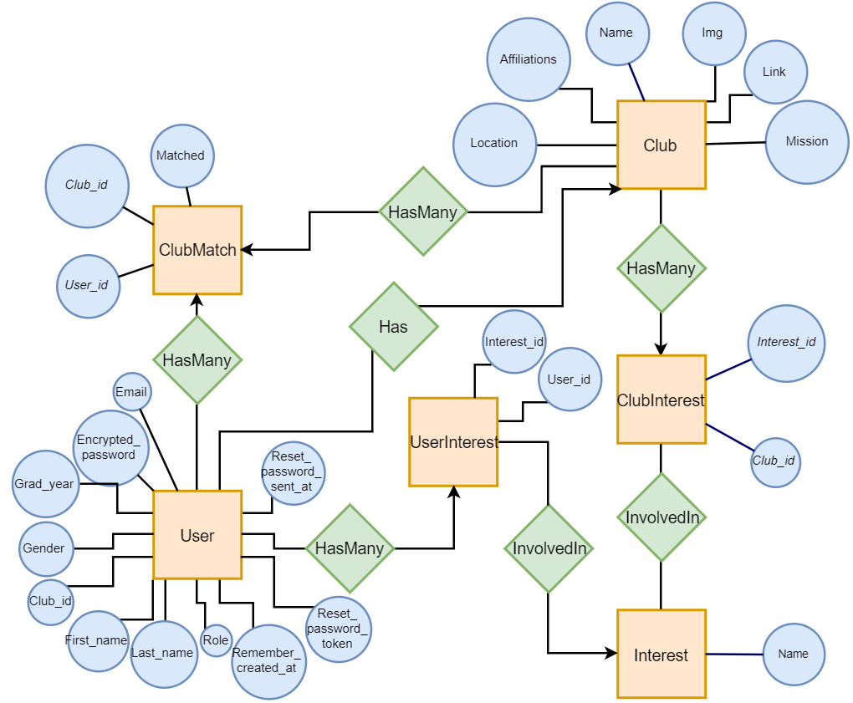
ER Diagram
Leah
Notes:
Leah

Slide 5


FRAMEWORKS/TECHNOLOGIES
Devise
BOOTSTRAP
JQUERY/AJAX
Flexible authentication solution for user model
CSS framework for general web app components
HTML manipulation and requests
Additional:
ChartKick, Groupdate, and Disqus
Sharon
Notes:
Sharon
Here are the frameworks & technologies that we used
Main frameworks include Devise, Bootstrap, and jquery/AJAX.
We also had some additional frameworks as well and those include chartkick, groupdate, and Disqus

Slide 6
DEVISE
USERS
CLUBS
ADMIN
Sharon
Notes:
Sharon

Slide 7
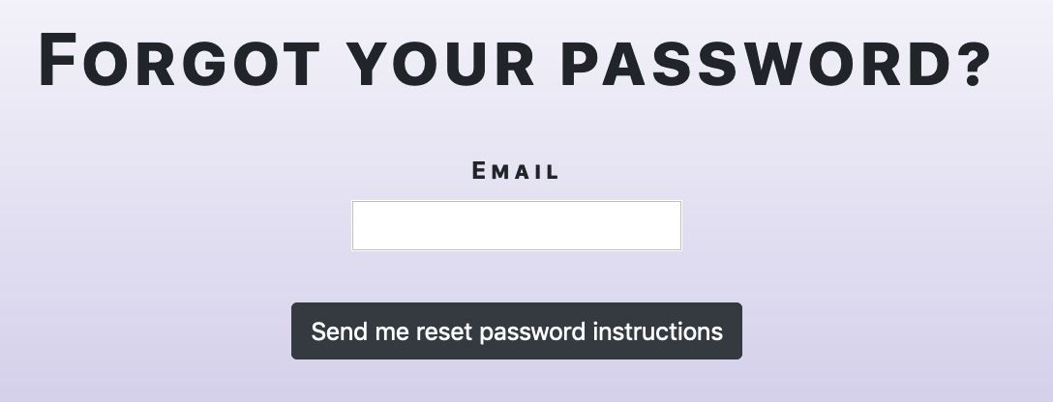
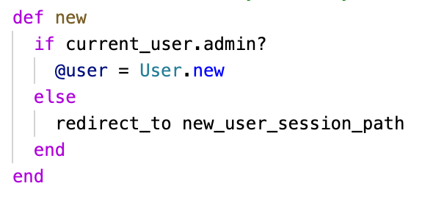
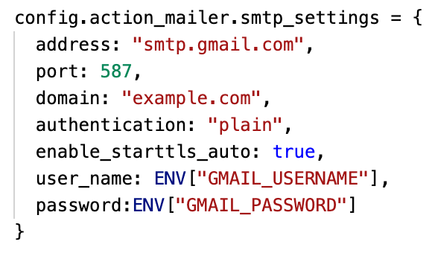
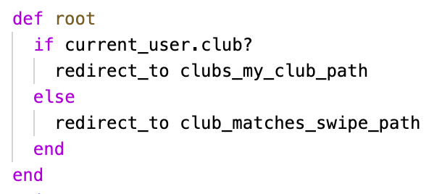
Authentication & Authorization
Sharon
Notes:
Sharon

Slide 8
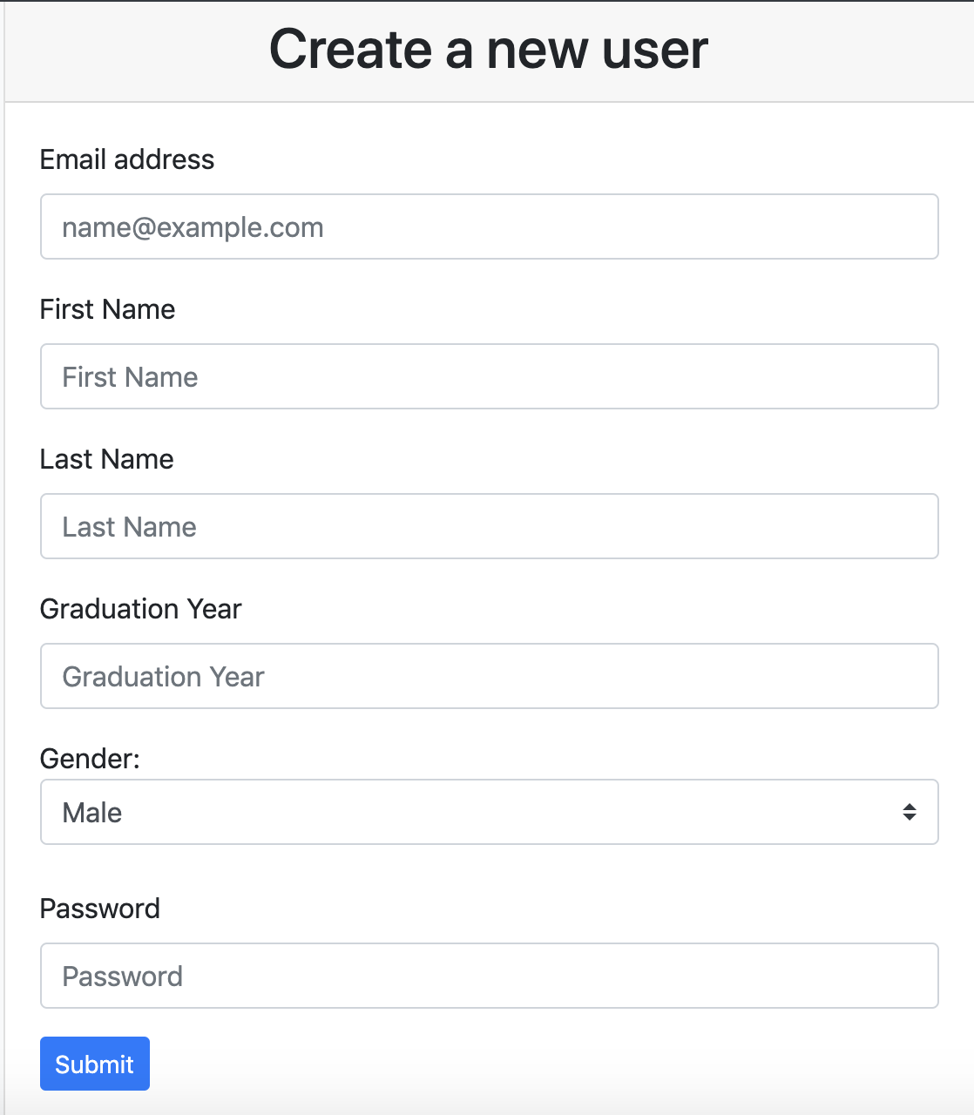
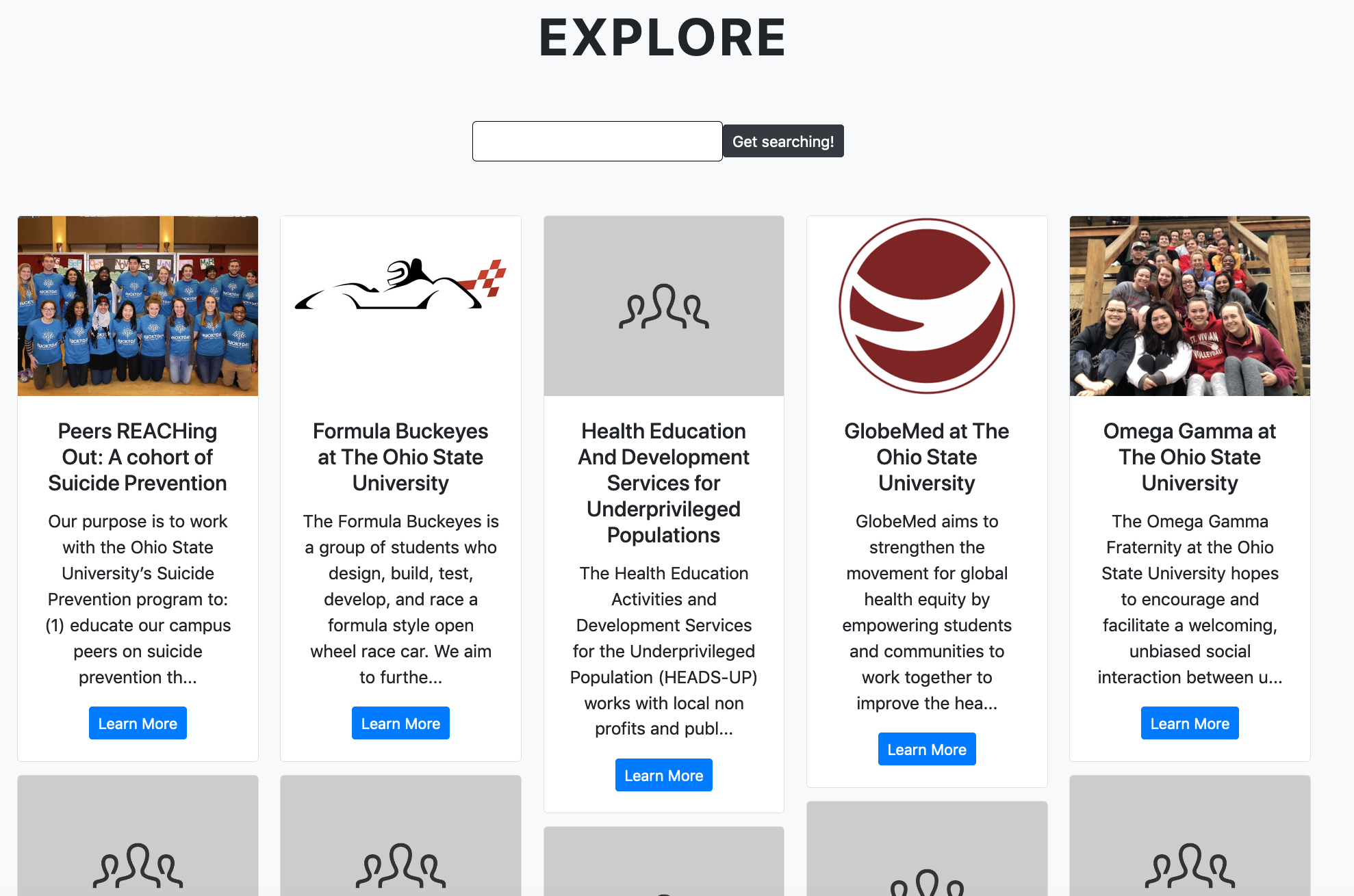
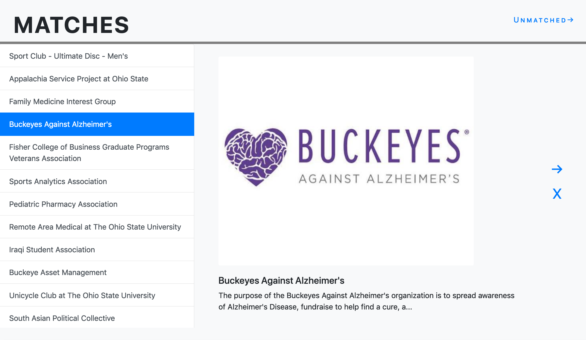
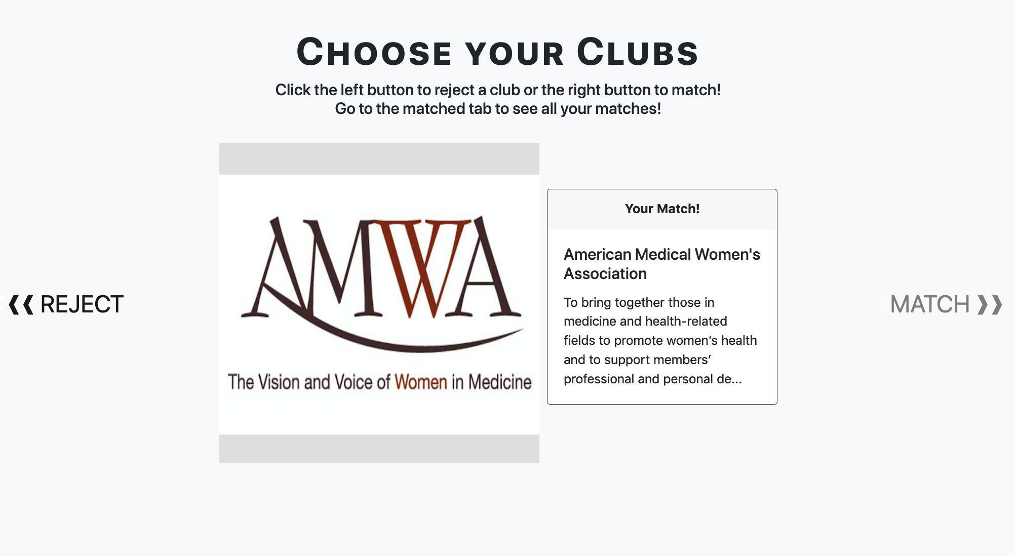
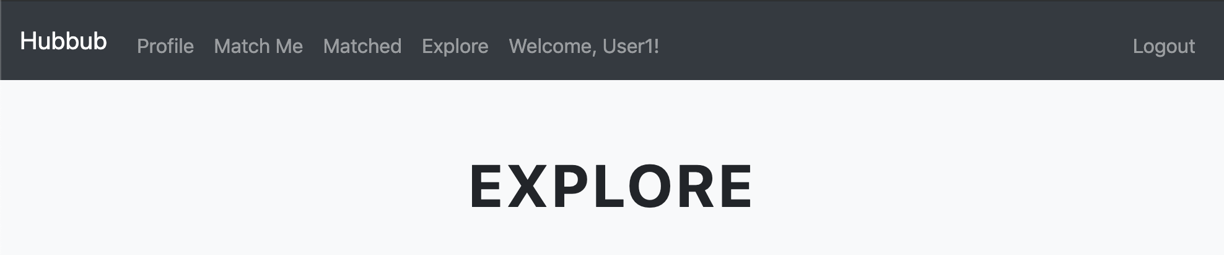
Bootstrap
CAROUSEL
CARD COLUMNS
LIST GROUPS
NAVBAR
FORMS & BUTTONS
Sharon
Notes:
Sharon

Slide 9
AJAX/JQUERY
REQUESTS
HTML MANIPULATION
Sharon
Notes:
Sharon
We used AJAX and JQUERY for two main reasons
First being requests
second being HTML manipulation

Slide 10
MOTIVATIONS FOR USAGE
DYNAMIC PAGE VIEW
ASYNCHRONOUS REQUESTS
Delete/update cards without re-rendering page
Keeping slide effect while updating slide-deck
Send request as user swipes
Sharon
Notes:
Sharon
This was used primarily for the swipe page
2 main motivations:
Create a dynamic page without re-rendering
deleting cards as you swipe
As nice as bootstrap is, the carousel component only allows you to slide backwards and forwards, looping back to the last slide rendered.
This is an issue because we display cards by their weight, which we’ll talk about later on.
Sending asynchronous requests
Wanted to send the request as the user swiped.
We’ll talk about how these goals were accomplished with AJAX & JQUERY more when we get into routes and main features later on in the presentation.

Slide 11
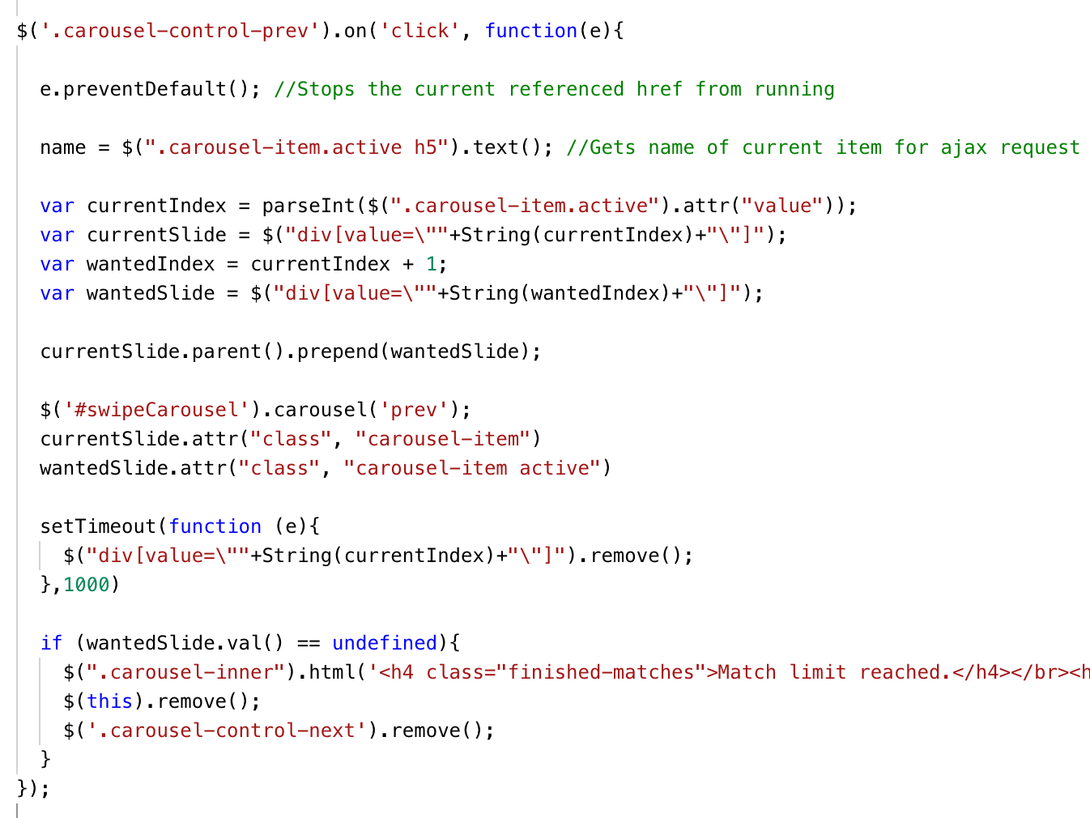
SWIPE AND DECK MODIFICATION
Action event listener for left control on slide carousel
Various information to swap cards & move to the front
Activate swipe motion & swap active card
Give the transition time to finish, then delete the previous card.
Check if there are no more matches
Sharon
Notes:
Sharon
We did this because bootstrap only has JQUERY support for events on slide transition or events after slide transition. This is problematic because we wanted to update the deck on left swipe, which goes to the previous match that you’ve already visited so updating the deck would interfere with transitioning to the next match if the event was fired on slide.
Key things to note:
It’s for the left swipe button on the carousel
Particularly important because of the nature of Bootstrap carousel control attributes. Has an attribute called data-slide that slides left or right to the previous or next slide. This is set that you can’t go to the next slide if you’re pressing left.
we wanted to override this.
To do this we needed to essentially swap the order of the slides dynamically.
We gathered various information to swap the slides and then pre-prended that slide to the front of the slides.
We then manually swiped to the wanted slide, swapping the active carousel item.
Then we updated the deck by deleting the previous item. We gave the transition time to finish, then deleted the previous slide by finding it with its index.
Finally we check if the slide deck is empty as we have a set match limit and if it is, we replace the carousel and the match & reject buttons with a message that tells you that the limit has been reached.

Slide 12
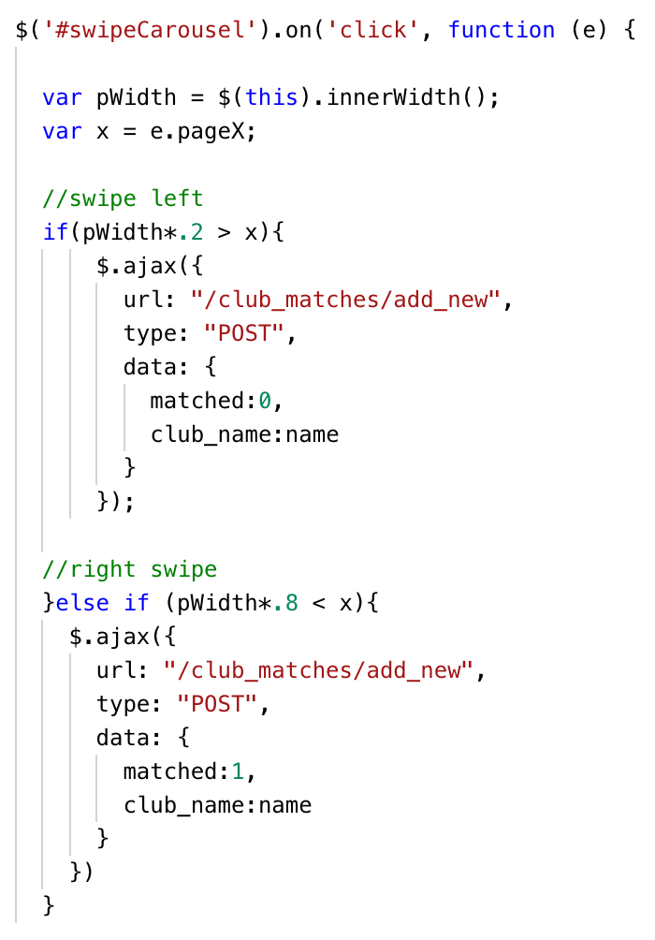
ASYNCHRONOUS REQUESTS
Action event listener for the entire carousel
Grab page dimensions
If click happens on the left side, it’s rejected
If click happens on the right side, it’s matched
Sharon
Notes:
Sharon
We also wanted to implement async requests while keeping the slide animation that bootstrap provided with carousels
To do this, we implemented an action listener on the swipe carousel
The first step was getting the dimensions of the element and the x coordinate of the event on the screen which as you can see is a mouse click.
We designate certain portions of the element that signify left and right, then compare this width with the coordinate.
If it’s on the left side then we send an AJAX request with matched = 0 meaning it’s rejected, and matched = 1 meaning matched if its on the right side.

Slide 13
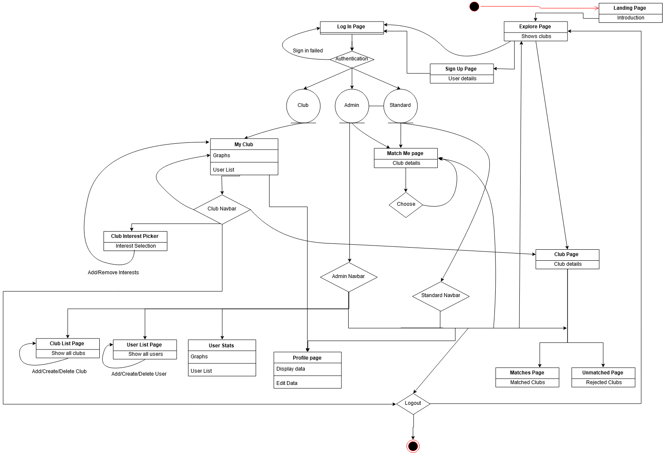
Landing Page
State Diagram
Login & Authentication
Club Navigation
Match Me
User & Admin
Navigation
Admin/Club Privileges
Sri
Notes:
Sri

Slide 14

Routes/Features
Search Function
Swipe Page and Matches
Roles
Rails ActiveRecord Query
AJAX and JQUERY usage and model changes
User vs. Admin vs. Clubs
Sri
Notes:
Sri

Slide 15
FUNCTIONALITY
USER
Admin
Clubs
Profile
Match Me
Display Matches
Display Rejected
Interests Page
Explore Page
Settings
User Functionality
User Stats
Club Stats
User info
Club info
CRUD operations for all accounts
Info profile page
Matched User list
User Statistics
Graph Statistics
Sri
Notes:
Sri

Slide 16
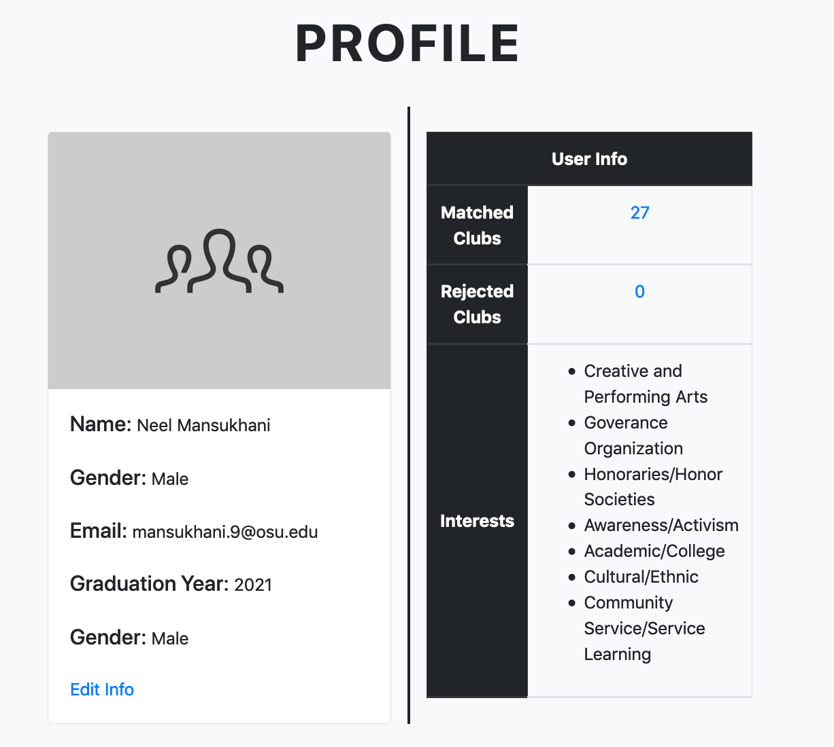
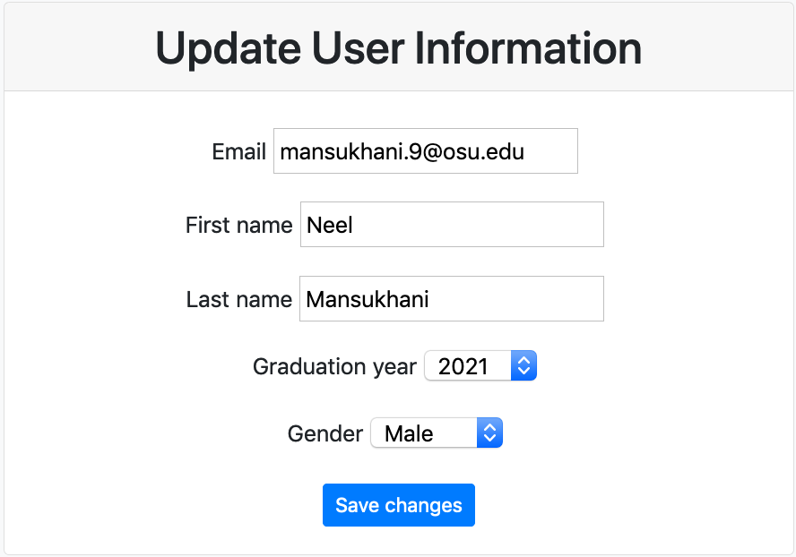
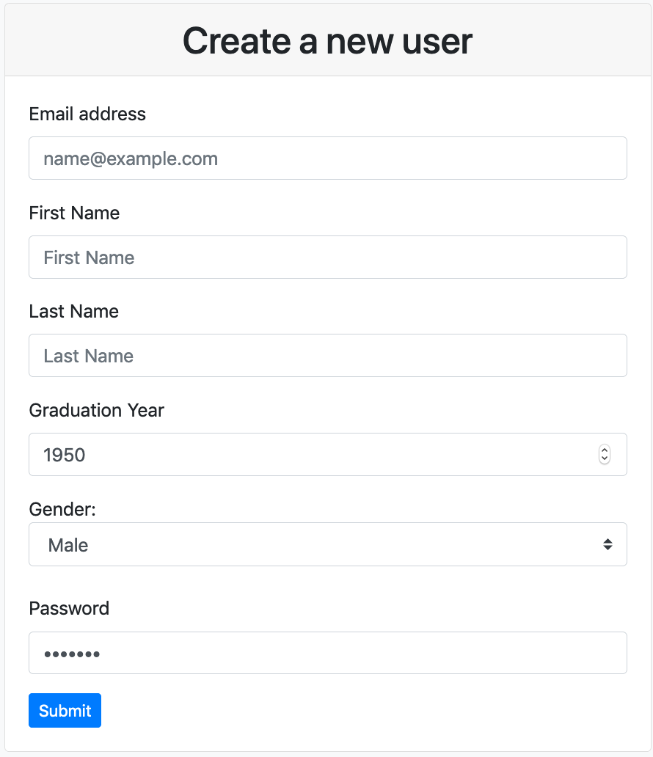
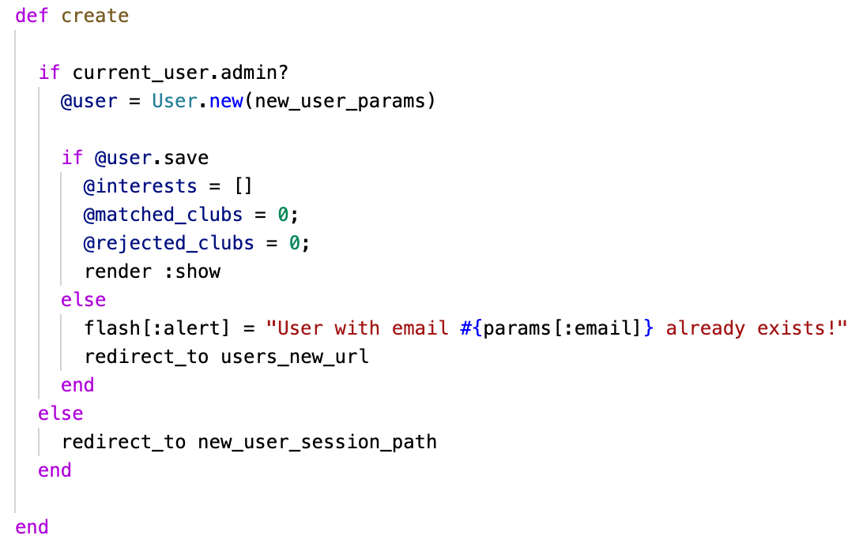
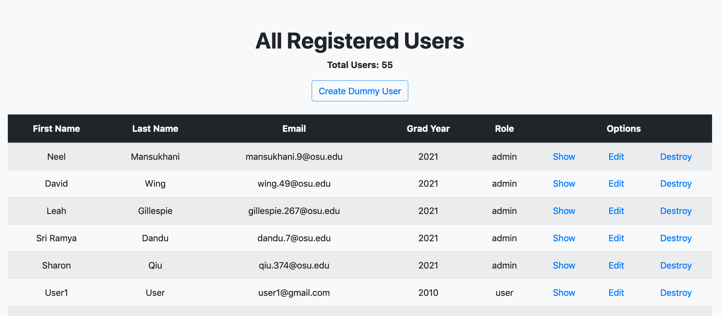
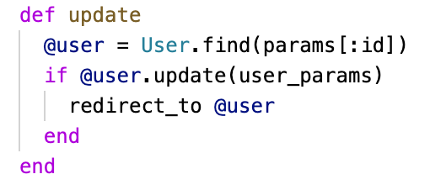
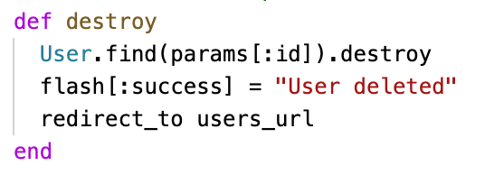
ADMINS
01
Index
05
Edit
02
Create
06
Update
03
New
07
Destroy
04
Show
Sri
Notes:
Sri

Slide 17
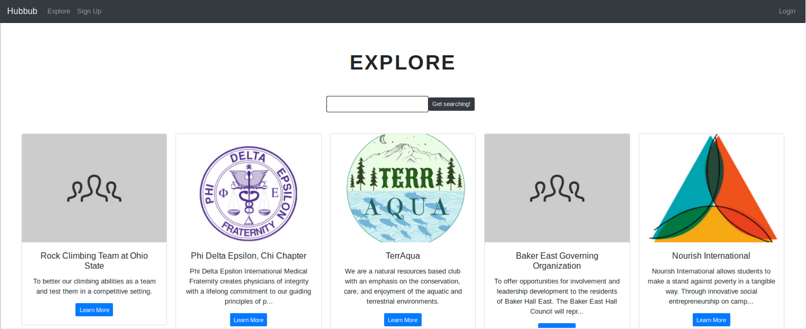
Explore Page
HEADER
SLIDER
Option to search for clubs by name
Club Logos
Link to Club’s Page
Works even if not logged in!
David

Slide 18
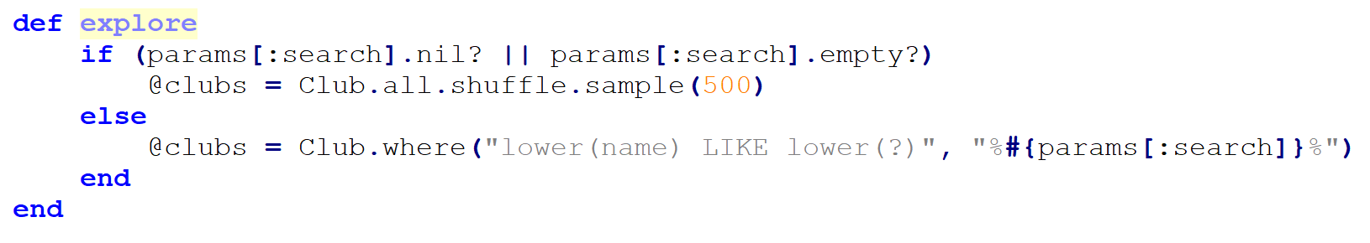
called from route or the view
params based on input to the search bar
define @clubs based on search parameters, or as 500 random clubs
Controller code for Explore
David

Slide 19
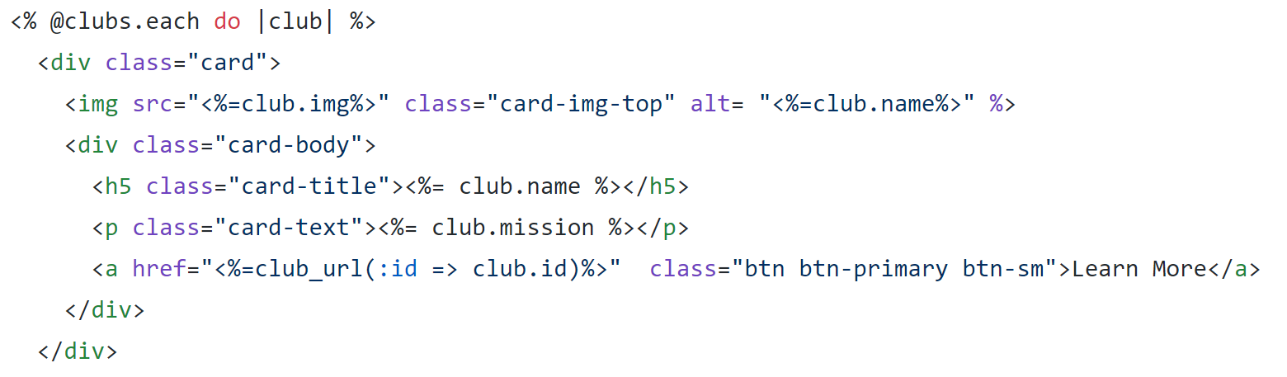
@clubs from the controller
Consistent Styling
Use Club’s Image
Link to Club Profile
ERB code for Explore page view
David

Slide 20
SWIPE AND MATCHES ROUTES
MATCHED/
REJECTIONS
PAGE
SWIPE PAGE
CLUB MATCHES MODEL
GET request to query from model
GET request to get potential matches
PATCH request to update a match
POST request to update model
David
Notes:
David
In terms of routing and interactions with the model, the swipe page sends a GET request onload to get the potential matches for a user. It also sends POST requests to update the model.
This in turn updates the club matches model.
These changes are ultimately reflected on the matched/rejections pages.
This page sends a GET request on load to get data from the model based on matched or rejected for the user.
The page also gives the user the option to update their matches and rejections, say they want to reject a previously matched club.
It sends a patch request to update the model to reflect these changes

Slide 21
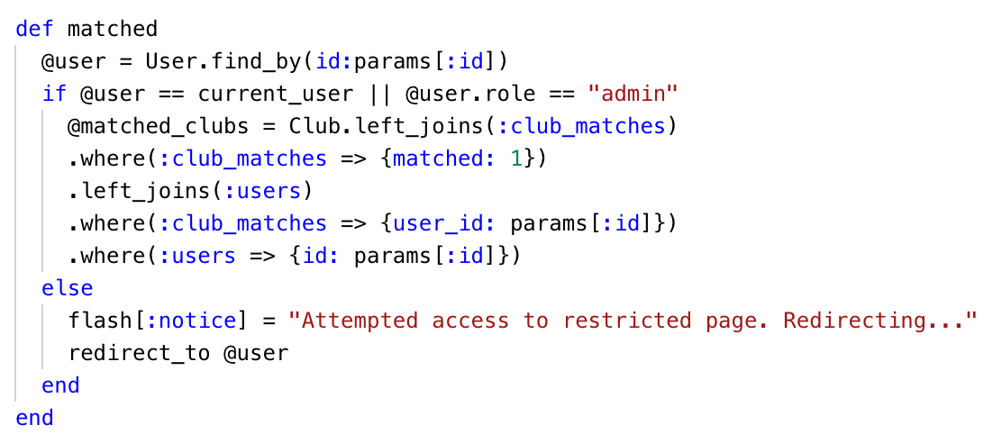
MATCHES/REJECTIONS PAGE CONTROLLER
Gets the club based on the club matches for a particular user.
David
Notes:
David
This is the controller that gets the matched or rejected information. This is the matches page so within this query we are essentially getting clubs based on club matches for a particular user such that they are matched to the club.

Slide 22
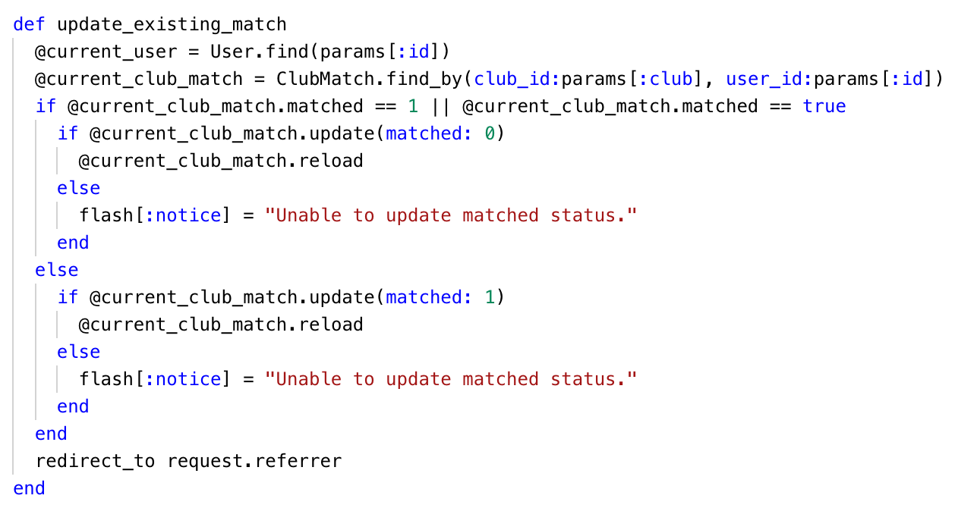
MATCHES/REJECTIONS PAGE CONTROLLER
Get club and user
Swap status using update. Then reload record.
Return to original page where the request came from
David
Notes:
David
We also gave users the option to match or unmatch from a club if they’ve already done so.
To do this:
We first find the club and the particular user.
We check the users status and swap matched using the update function.
We then reload the match and re-render the page

Slide 23
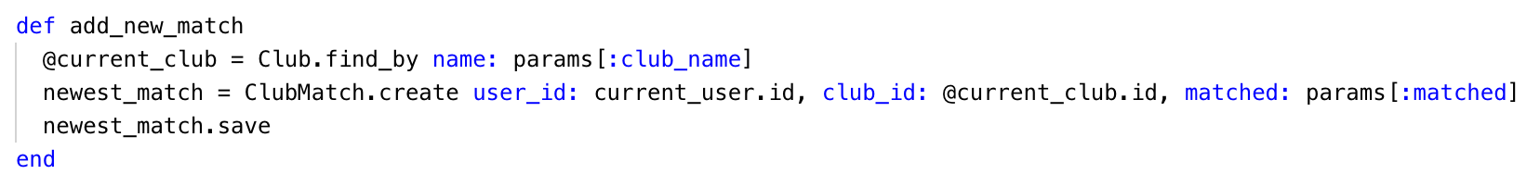
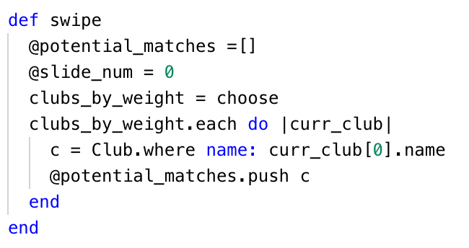
SWIPE PAGE CONTROLLER
Get club by name,
Create the record,
Save the record
Get club by name
and appending the potential clubs as we grab them from the model.
David
Notes:
David
This is the controller code
First part:
Pretty self explanatory, we get the current club by its name which we passed in in the AJAX request
Then we created a record and saved it
Second part:
Grabs potential matches based on choose algorithm
Grabs the clubs from the club model where all the club information is stored and pushes each match into the potential matches array for use

Slide 24
Collaborative Filtering
Machine learning algorithm
Creates recommendations based on matches that users have in common
Takes user interests into account
Neel
Notes:
Neel

Slide 25
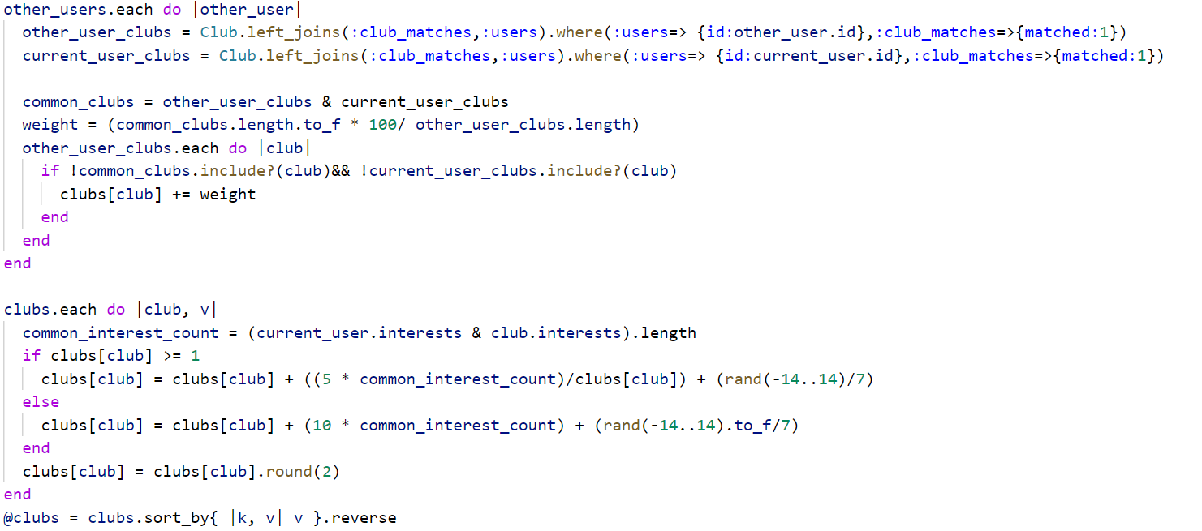
Collaborative Filtering
If users have more in common, then weight added is more significant
Add weight based on interest
Neel
Notes:
Neel

Slide 26

FULL ROUTE IN ACTION
Neel
Notes:
Neel
Here we see the routes in action. We can match/reject clubs on our match me page, which is then shown to have sent the request, because the results appear on our matches/rejected page.

Slide 27
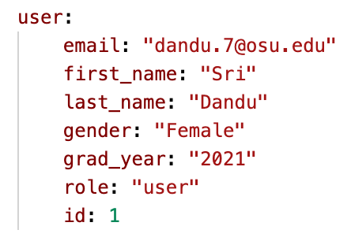
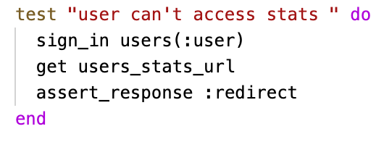
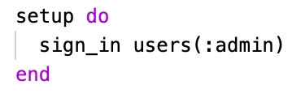
Testing
01
02
03
Testing Models
Testing Routes
Integration Testing
Via Rails Console
Create Users in fixtures
Database Testing
Whitebox Testing
Via localhost
Controller Testing
Blackbox Testing
Via localhost
Neel
Notes:
Neel

Slide 28
DEMO

Slide 29
IMPACT AND FUTURE WORK
Why is this Important?
Who this helps
Students trying to find new passions
Clubs trying to get more reach
Additional Implementation
Expand beyond clubs
Communication between clubs and users
Additional authentication
Notes:
We can expand to finding new classes for students
we can add checks to see if users are students

Slide 30
QUESTIONS?

Slide 31


